Slide 1

Predicting customer buying behaviour
SHUBH SHARMA
30/06/2024

Slide 2
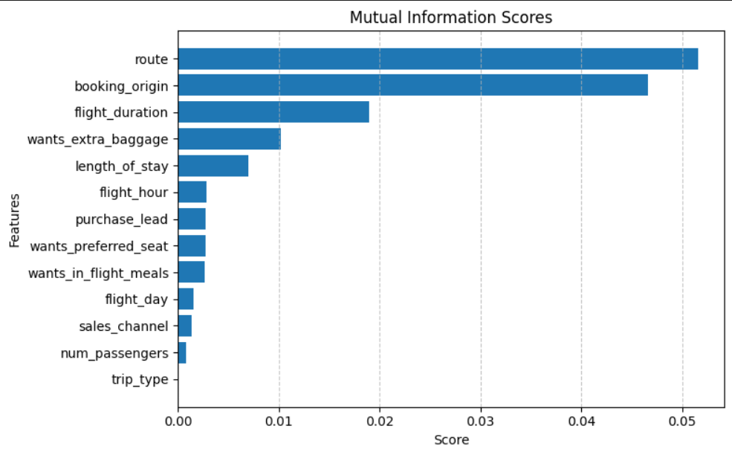
predictive model to understand factors that influence buying behaviour
Model Performance Metrics
Accuracy: 85.37%
AUC Score: 0.568
Key Influential Features
Route
Booking Origin
Flight Duration
Wants Extra Baggage
Length of Stay
Objective
To increase AUC Score to enhance predictive power and precision of customer buying behavior.

